Slide 1
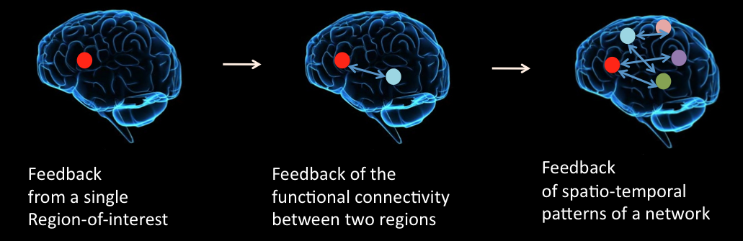
Self-regulation of Brain Activity:
Applications in Neuroscience Research & Clinical Rehabilitation
Control of Single Brain Regions to
Control of Brain Networks…
Dr. Ranga Sitaram
Asst. Professor, BME

Slide 2
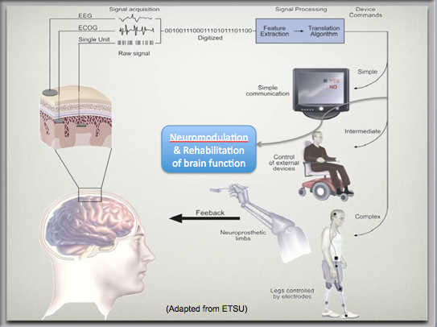
Brain-Computer Interface & Neuroprosthetics

Slide 3

BCI for communication in paralysis

Slide 4
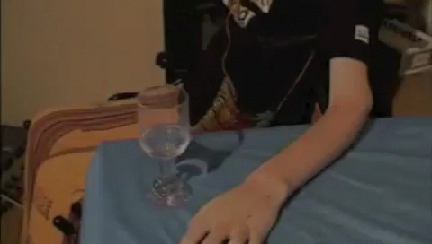
BCI for Movement Restoration

Slide 5
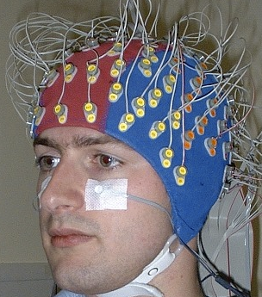
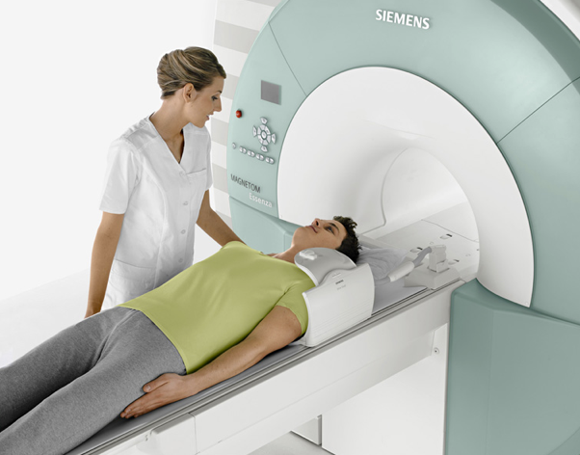
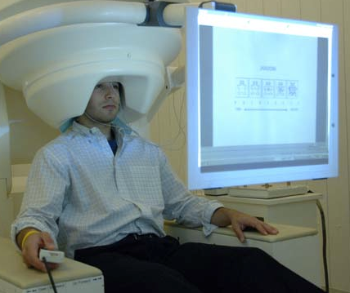
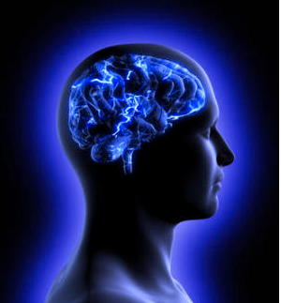
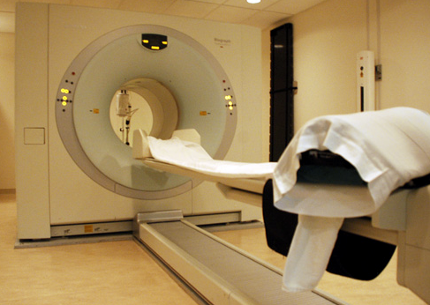
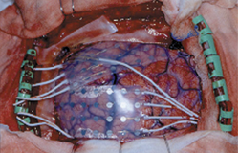
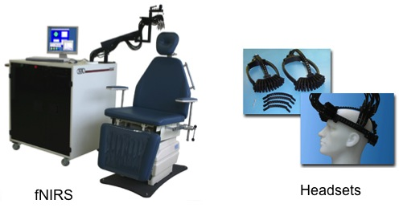
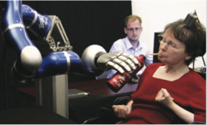
Neuroelectric/magnetic
Hemodynamic/metabolic
Magnetic Resonance
Imaging (fMRI)
Electroencephalogray (EEG)
Functional Brain
Imaging Methods
Magnetonencephalogray (MEG)
Positron Emission
Tomography (PET)
Electrocorticography (ECoG)
Near Infrared
Spectroscopy (NIRS)
Implantable Electrodes

Slide 6
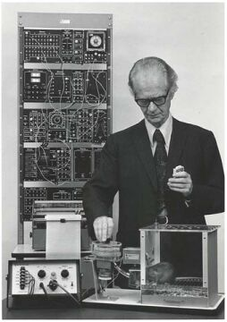
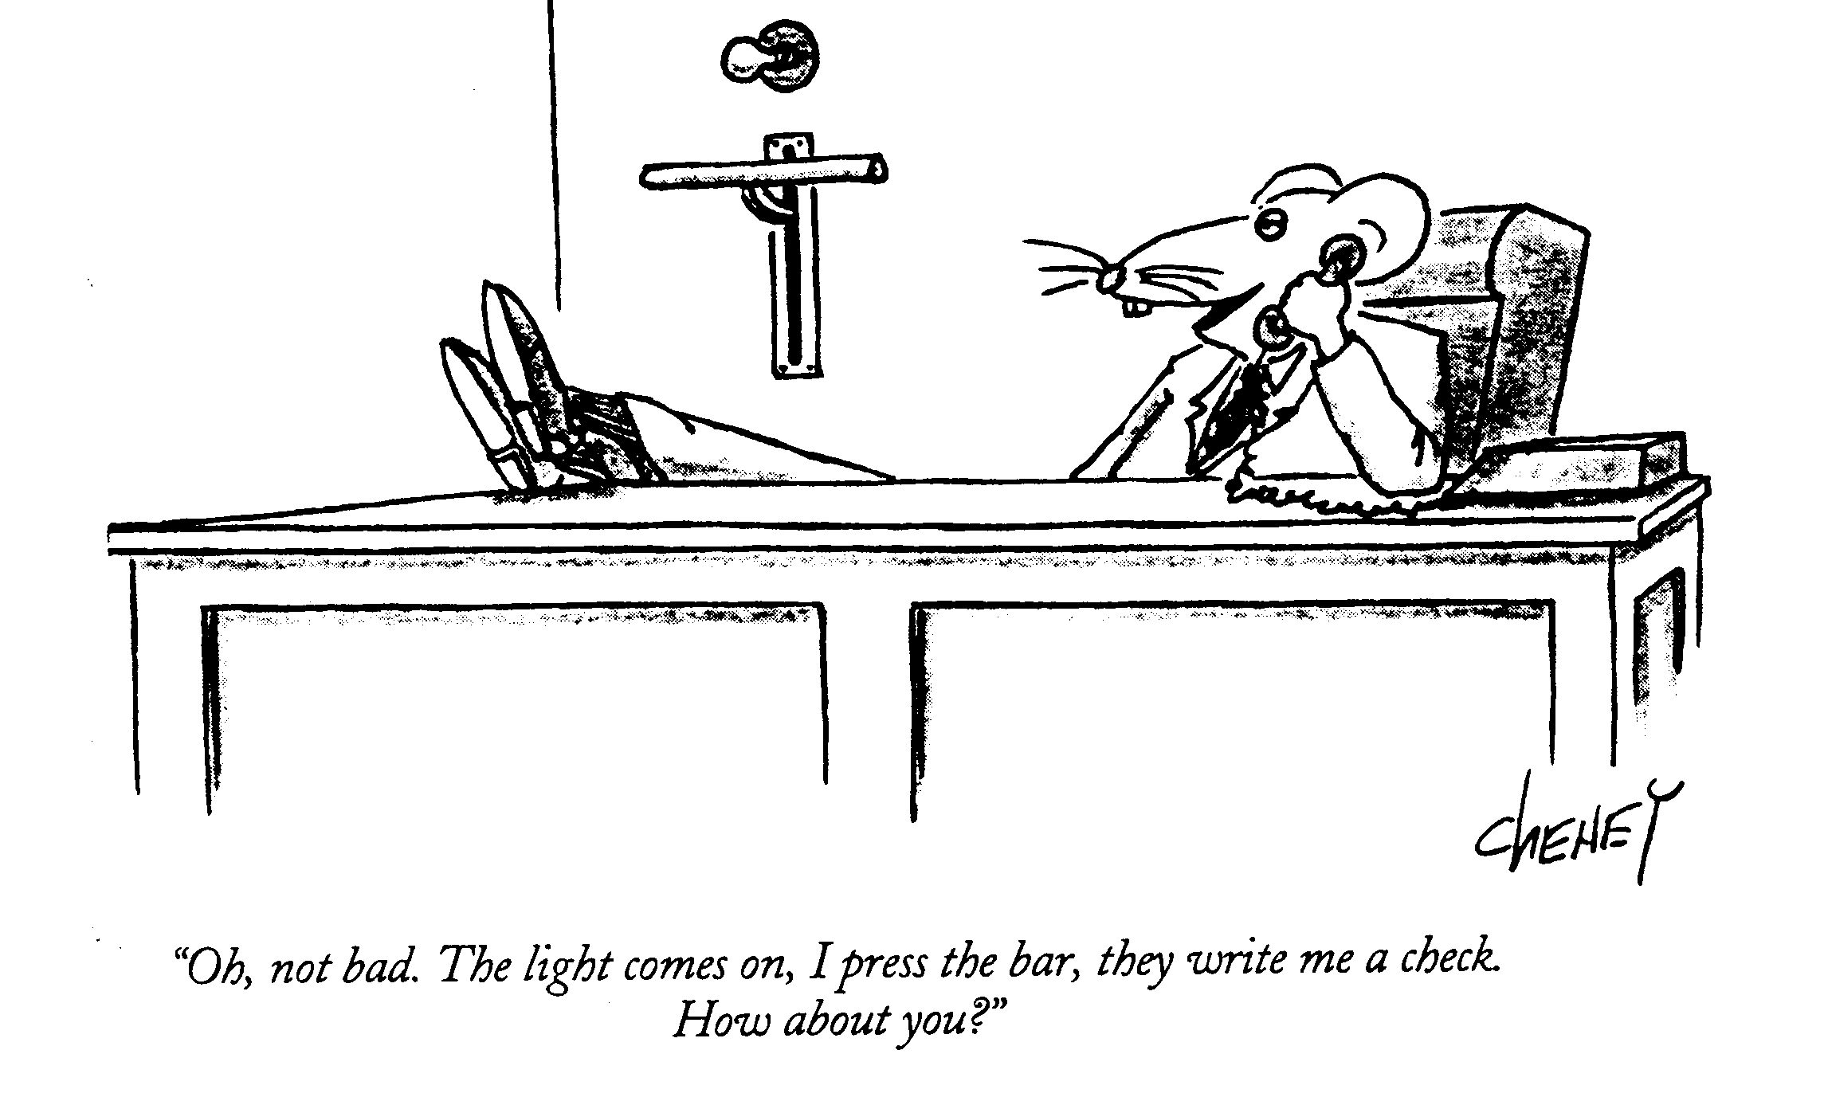
BCI and Neurofeedback systems are based on the theory of operant learning
It is a type of learning through which behavior of an organism is changed by providing a reforcement after a behavioral response.
The same principle is applied in training people to self-regulate a specific brain signal with a BCI system.
B. F. Skinner (1904-1990)

Slide 7

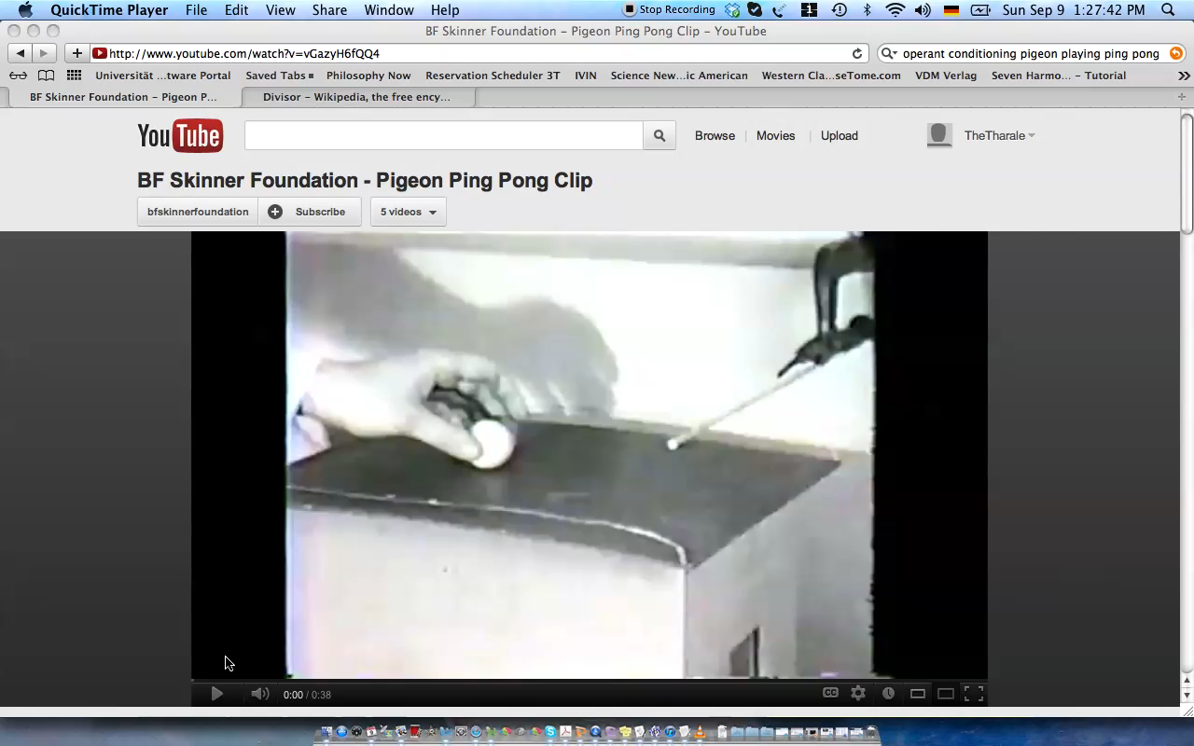

Slide 8
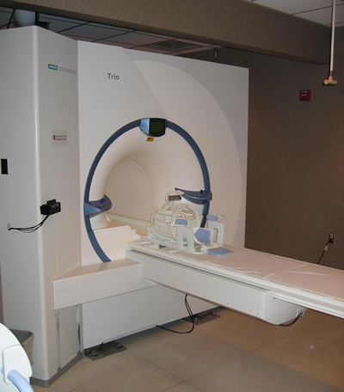



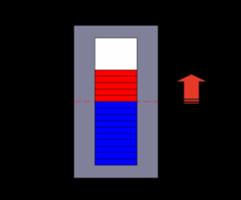
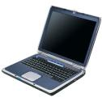
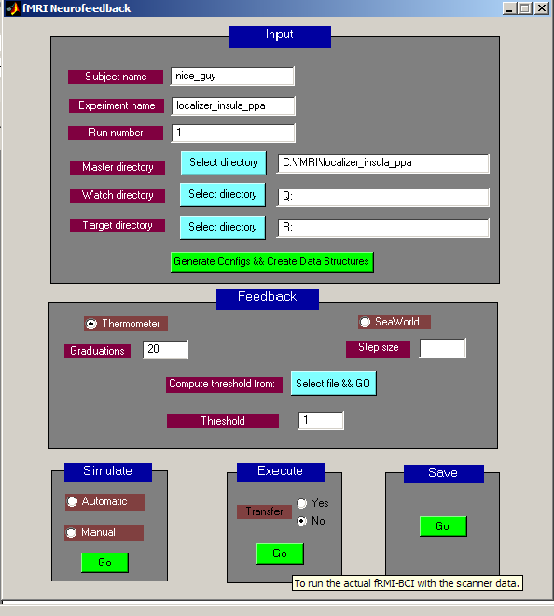
fMRI Brain-Computer Interface
Signal Acquisition
Custom-built scanner program
raw images
Signal Analysis
Signal Feedback
Participant
preprocessed
brain activity
BCI Program
Sitaram et al 2008, 2010; Caria, Sitaram 2011

Slide 9
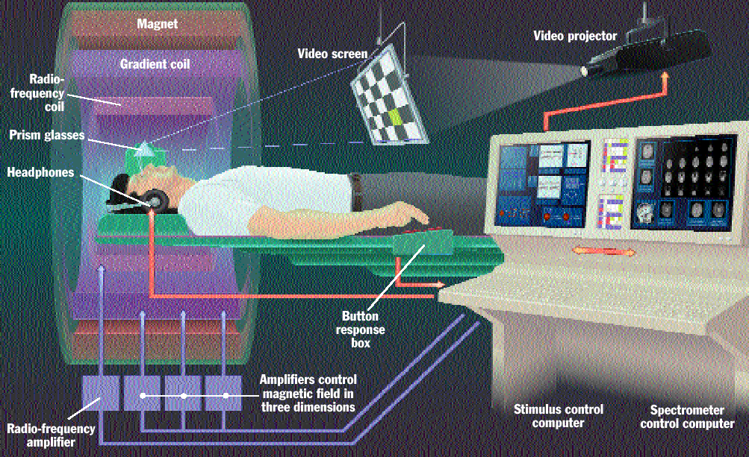
fMRI Setup
Source: Jody Culham

Slide 10
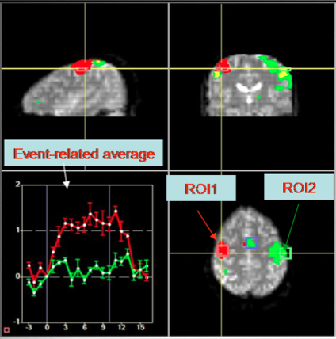
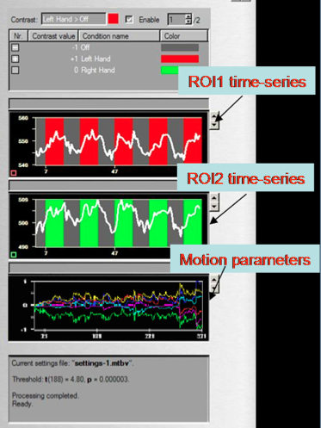
fMRI-BCI: Real-time Signal Analysis

Slide 11
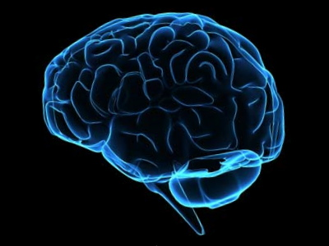
SINGLE REGION OF INTEREST CONTROL
EXAMPLES OF:

Slide 12
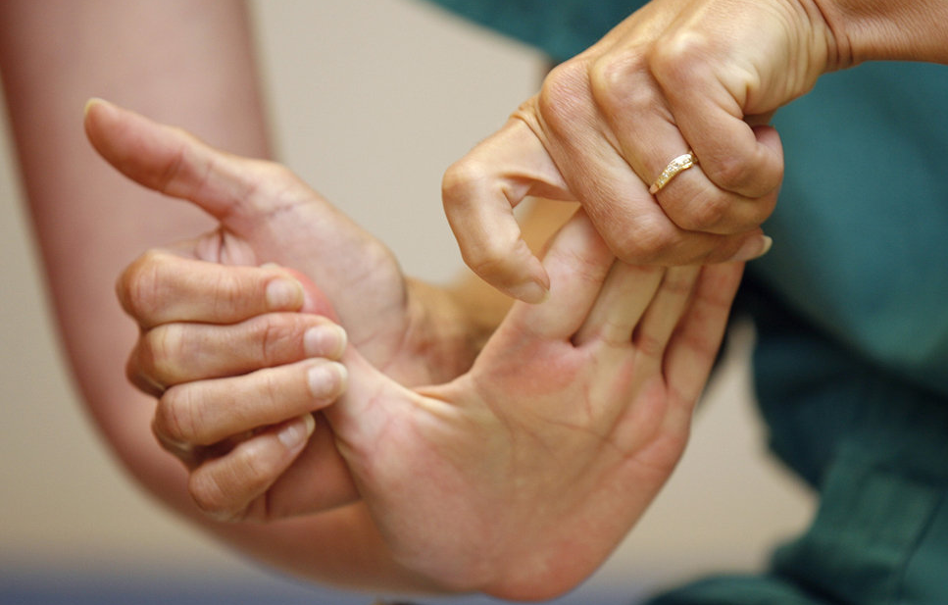
Regulation of Ventral Premotor Cortex in Stroke Patients
Sitaram et al. (2011)
Journal of Neurorehabilitation and Neural Repair.

Slide 13
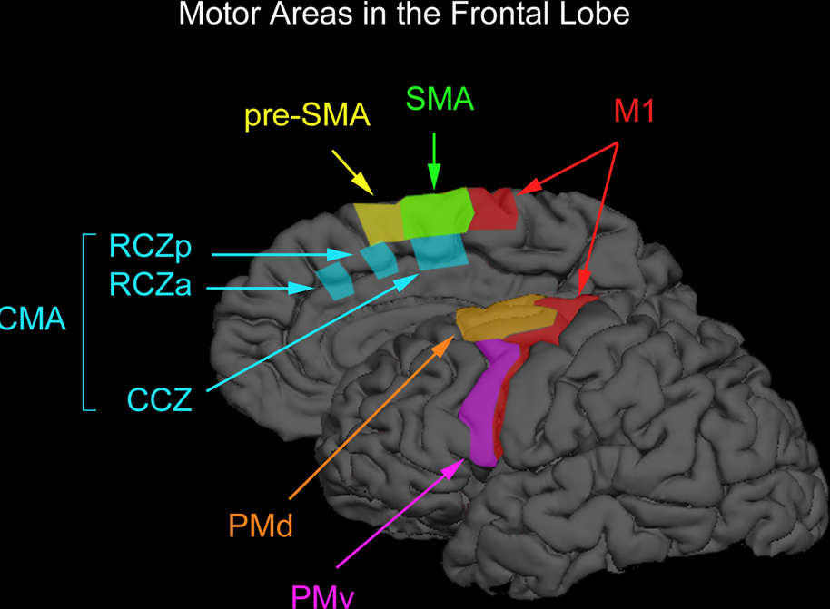
Ventral Premotor Cortex and Facilitation of Movement
When M1 is legioned due
to stroke, limb
movement is affected.
PMv and M1 are
anatomically connected.
Activation of PMv facilitates M1 output and motor function.
Sitaram et al. 2011

Slide 14
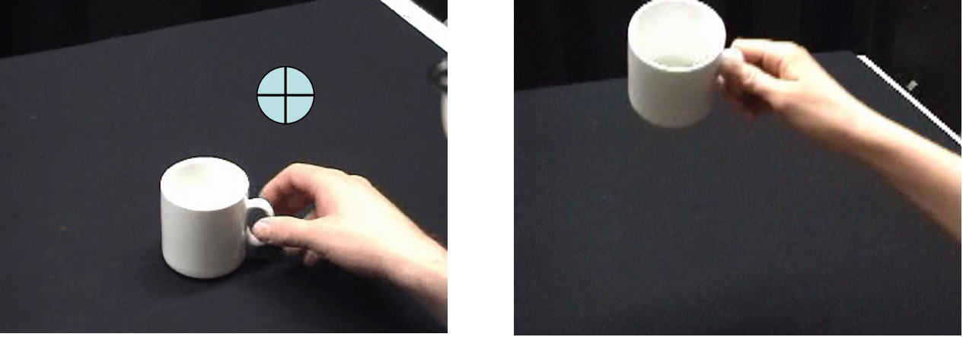
fMRI-BCI with BOLD feedback from vPMC.
Real-time video
feedback
Real-time
thermometer
feedback
Sitaram et al. 2012

Slide 15
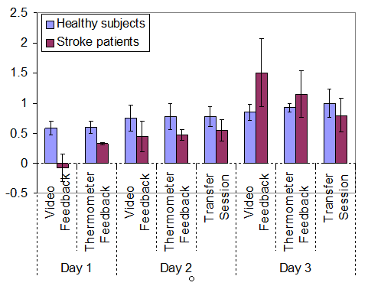
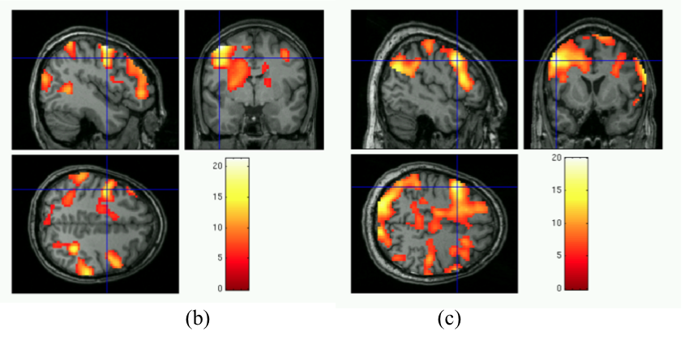
BOLD Signal in the PMv
Sitaram et al 2012

Slide 16
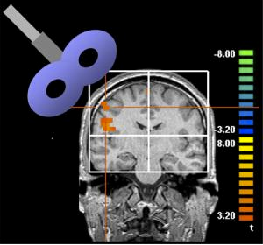
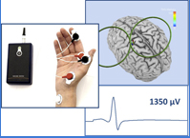
Effect of self-regulation training
tested by Trascranial Magnetic Stimulation

Slide 17
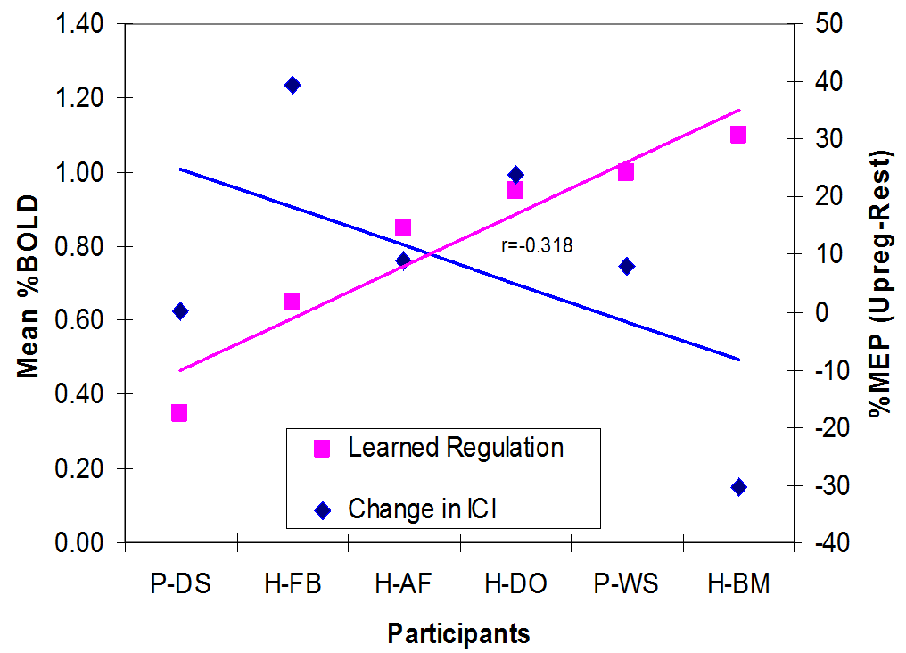
Correlation between Post-training
BOLD Increase in PMv and
Intracortical Inhibition (ICI)
Sitaram et al 2012

Slide 18
Application of real-time fMRI-BCI to Schizophrenia Research
Article: Caria, A, Sitaram, R. et al.,
(Neuroimage 2007; Biological Psychiatry 2010).
Article: Ruiz S, .., Sitaram R. Volitional control of insula enhances emotion recognition and effective connectivity.
Journal of Human Brain Mapping (2011)

Slide 19
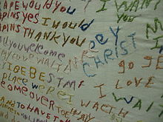
Schizophrenia
Mental disorder characterized by disintegration of thinking and emotional responsiveness.
Embroidery by a schizophrenic

Slide 20
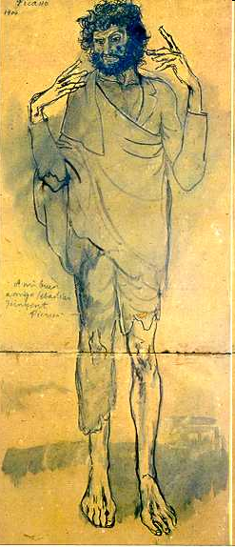
Schizophrenia
Positive Symptoms
Hallucinations
Delusions
Paranoia
Negative Symptoms
Apathy
Anhedonia
Poverty of speech
Blunted affect
The term positive symptoms refers to symptoms that most individuals do not normally experience but are present in schizophrenia.
Negative symptoms are those that are NOT present in schizophrenic persons but are normally found in healthy persons.
Social Dysfunction
Study aim!
Cognitive Deficits
Attention, Memory
Executive Functions
Social Cognition

Slide 21
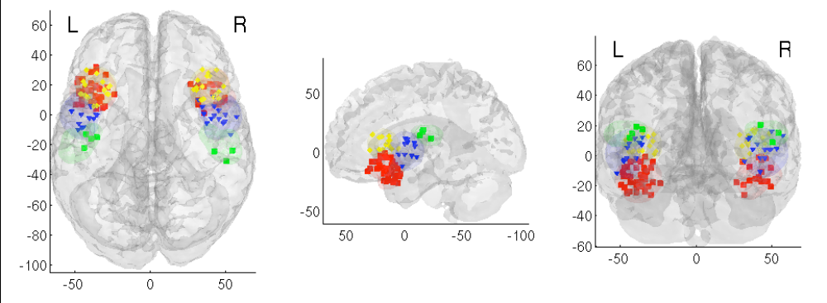
Emotion and Insula
Anterior Insula is activated during:
1. self-generated emotions (Damasio et al, 00)
2. assessment of emotional intensity (Anders et al, 04; Phan et al, 04)
3. social phobia and antisocial behavior showing hyperactivity and hypoactivity (Veit et al., 2002; Birbaumer et al., 2005).

Slide 22
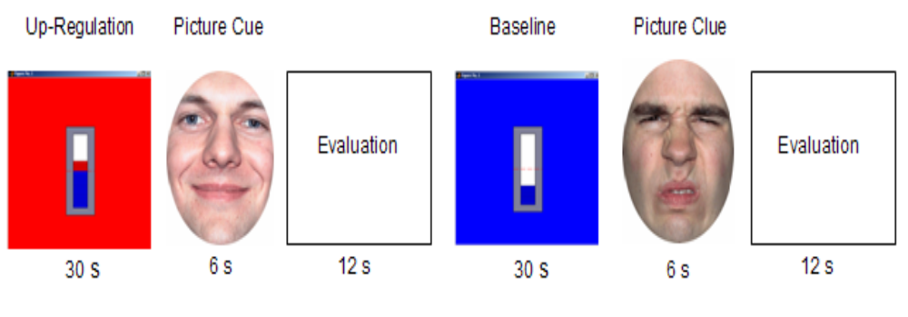
Experimental Protocol
Patients performed:
a) a pre-training emotion recognition task,
b) 12 fMRI-BCI insula self-regulation training sessions,
c) a post-training emotion recognition task.
Evaluation:
Recognize emotion type
Rate intensity level of emotion

Slide 23
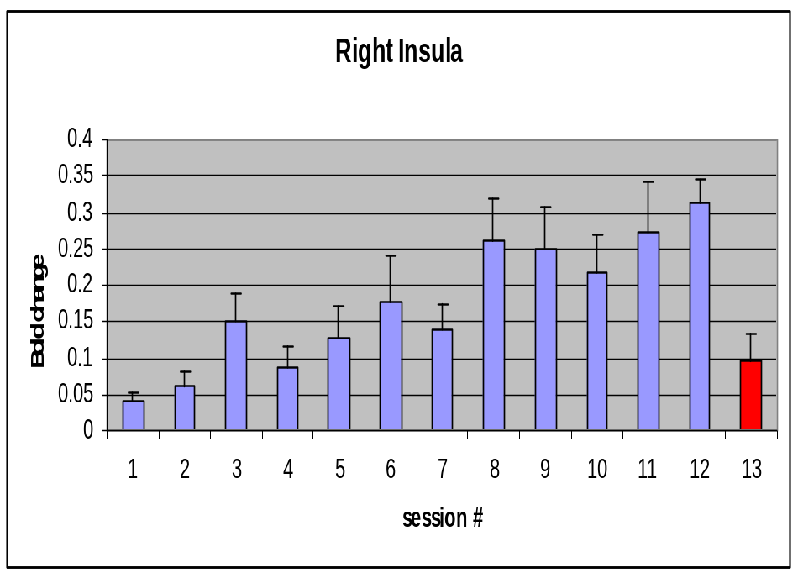
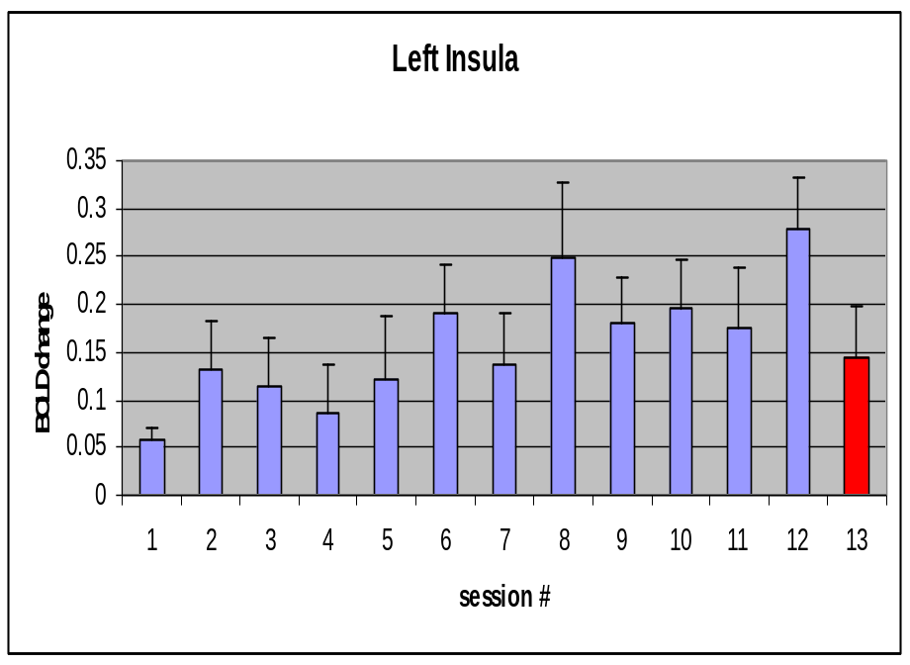
Results: Percentage signal changes in anterior insula with training
A significant negative correlation between severity of schizophrenia and % BOLD increase during up-regulation

Slide 24
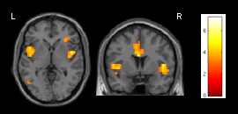
Training Effect: Last vs First Session
Random effect group analysis of last session vs first showed a significant activation clusters in anterior left insula (t = 4.83; p < .001) and anterior right insula ( t = 3.86; p < .05).

Slide 25
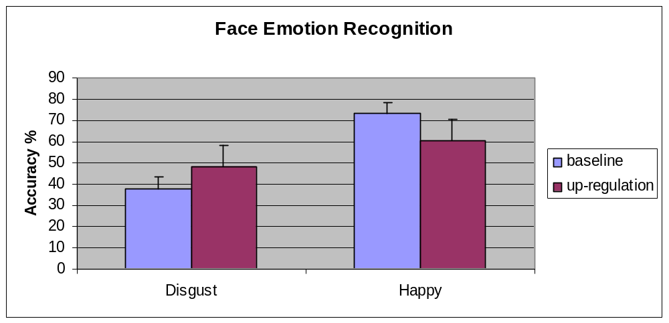
Effect of Self-regulation on emotional behaviour
Emotion recognition
Schizophrenic patients identified significantly more disgust faces after up-regulation (48.3% ± 23.97, mean ± SD) than after rest (37.7% ± 17.69 %, mean ± SD).
**
**
Accuracy (and standard error) for face emotion detection during baseline and up-regulation of insula cortex.
* and ** p < .05
*
*

Slide 26
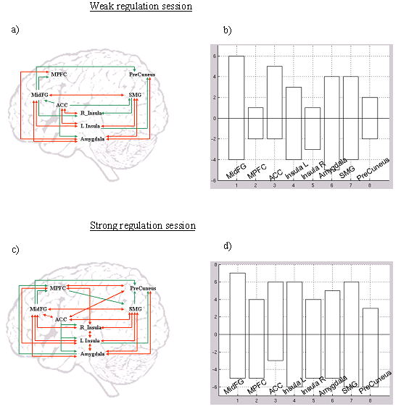
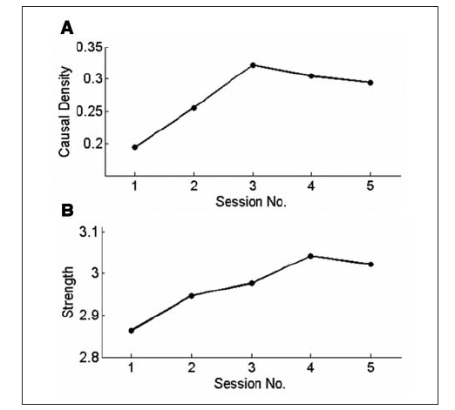
Effect of self-regulation training on brain connectivity
(Ruiz,., Sitaram 2011, Lee,.,Sitaram, 2011)

Slide 27
FUNCTIONAL CONNECTIVITY CONTROL
EXAMPLE OF:

Slide 28
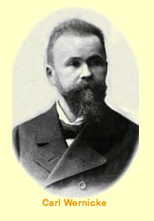
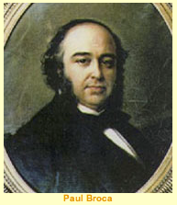
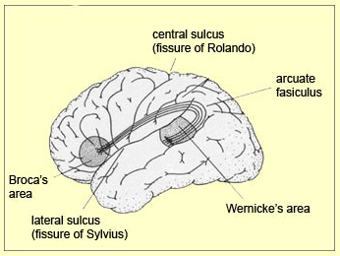
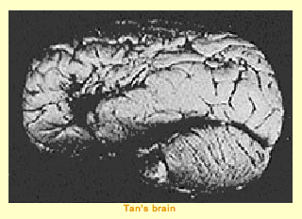
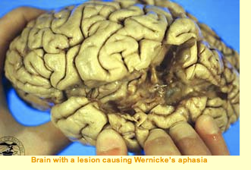
Broca and Wernicke brain regions in speech production and comprehension

Slide 29
Will learned increase of functional connectivity between Broca (IFG) and Wernicke (SFG) areas improve language performanace?
Sergio Ruiz,
Mohit Rana,
Katherina Sass,
Tilo Kircher,
Niels Birbaumer,
Ranganatha Sitaram Funded by: DFG BI 195/64-1

Slide 30
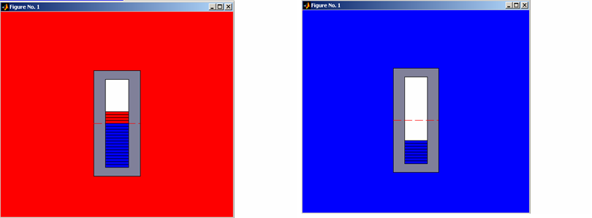
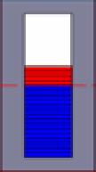
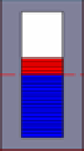
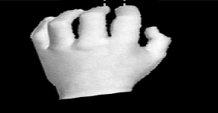
Experimental Protocol
Baseline
Up-regulation
Semantic
Priming Task
Semantic
Priming Task
21s / 14TR
4.5s / 3TR
21s / 14TR
4.5s / 3TR
Attention Cue
Prime
Target
Language Test
+
Sweet
Candy
#
500ms
350ms
1000ms
2650ms*
Answer
„non word“
„real word“
(Suslow et al 2002)

Slide 31
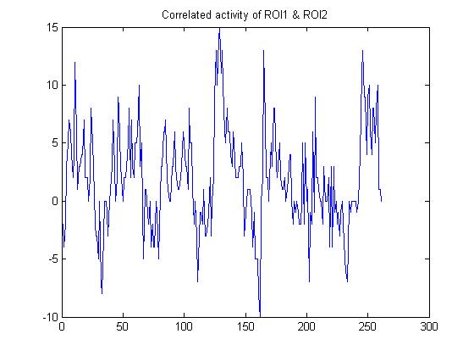
Results
Functional connectivity during modulation during feedback training

Slide 32
Effect of connectivity increase on language task
Note:
“Enhancement of the priming effect” (EPE) =
(Priming effect following Self-regulation) – (Priming effect following Baseline)

Slide 33


Application:
Studying and Treating Aphasia
An ongoing collaboration with a medical university in India.

Slide 34
CONTROL OF A FUNCTIONAL NETWORK
EXAMPLES OF:

Slide 35

Real-time Brain State Classifier
Sitaram et al., 2011

Slide 36


2. Multiclass classification (Happy, Disgust, Sad)
- Chance accuracy: 33%
3. Adaptive classifier training (Happy vs. Disgust; 2 participants)
Rest
Happy
Rest
Disgust
Rest
Sad
...
T. Ses. 1
T. Ses. 2
Ses. 1
Ses. 2
Ses. 3
Sitaram et al. (2011)
Notes:
In experiment 2, multi-class classification was performed with 4 participants.
In this experiments, we used one positivie emotion and two negative emotions disgust, sadness to investigate whether specific discrete emotions could be classified.
The protocol in this experiment is very similar to the binary case.
In experiment 3, I tested the adaptive classifier training with the two emotions to show whether adaptive classifier training improve the classification performance in the extended feedback training.
In multiclass classification, the performance with and without feedback is higher than the chance level.
In experiment 3, the adaptive classifier can improve the classification performance.

Slide 37

INTERPRETABILITY
Brain activations determined by the classifier
Sitaram et al 2011
Sitaram et al (2010)
Notes:
Subgenual – subgenual cingulate (BA25), Nac – nucleus accumbens, PVC – primary visual cortex, DLPFC – dorsolateral prefrontal cortex, LiG – lingual gyrus, VLPFC – ventrolateral prefrontal cortex, STG – superior temporal gyrus, MiTG, middle temporal gyrus, MFG – medial frontal gyrus, SFG – superior frontal gyrus, MiFG – middle frontal gyrus.

Slide 38

An open toolbox for real-time pattern classification
(Rana, Sitaram, 2012)

Slide 39


Application:
Anxiety and Post-traumatic Stress
An ongoing collaboration with Prof. Peter Lang and Prof. Margaret Bradley (UFL)

Slide 40
Summary
Real-time fMRI is a powerful tool for neuroscience research on brain-behavior relations.
Technology is now mature to control single regions in the brain, to functional connections, to a whole functional circuit.
Preliminary experiments in patients of neurological and psychiatric disorders show clinical potential. Future progress in MR, signal analysis and pattern classification would bring experimental results to mature applications.
However, MR is expensive and complex as a technology. More affordable and portable brain acquisition technology should help in translation of the research to practical applications.

Slide 41


Slide 42



Multichannel Functional
NIRS

Slide 43


fNIRS Signals of Motor Imagery
(Sitaram et al., 2007)

Slide 44

Application 1: fNIRS-BCI for Completely Paralyzed to Communicate
(Sitaram et al 2007)

Slide 45



Application 2:
Real-time fNIRS & Exoskeleton for
Recovery of Lower Limb Movement
Experimental Instrument
Optode Positioning
Hitachi ETG4000 System
An ongoing discussion with Prof. Janis Daly, CBRR, UFL.

Slide 46

Movement Prediction by Posterior Parietal fNIRS Signals
Hip and Leg

Slide 47

A Cloud-computing platform for simultaneous mutli-brain measurements

Slide 48


Connectomics
Applications: Connectivity and Blood Perfusion abnormalities in Parkinsons, Stroke and Dementia.
Diffuse Tensor Imaging (DTI)
White Matter
(Varkuti,.., Sitaram, 2011, 2012 in press)

Slide 49
Interdisciplinary Research
IInterested researchers and students, please contact:
ranganatha.sitaram@bme.ufl.edu
Neuroimaging Technology
(fMRI, EEG/MEG, fNIRS, TMS…)
Computational Systems
(signal analysis, pattern classification, ..)
Neuroscience, Neurology, Psychiatry
Thank you!

